Slide 1



Football III
Produced by Dr. Mario | UNC STOR 538

Slide 2

Football States and Values
Advantages of States
Recall: Use in Baseball
Purpose: To Evaluate Expected Outcome and Winning Probability
from Different Strategies
Purpose in Football
Analyze the Effectiveness of Offensive Plays
Determining Strategies on Fourth Down
Picking Defense Formations to Restrict Opponent

Slide 3
Football States and Values
Football States Defined by …
Yard Line
Down
Yards to Go for First Down
Score Differential
Time Left in Game
There is a Massive Amount of States
$$Number of States=99×4×30×80×60=57,024,000$$
Assumption About Yards to Go
Assumption Score Differential
Assumption About Time Remaining

Slide 4
Football States and Values
Needs Simplification
Maximize the Expected Point Spread
Assume Game is of Infinite Length
Time Remaining Becomes Irrelevant
Current Score Differential Becomes Irrelevant
Method Devalued During Ends of 2nd and 4th Quarter
New Defined States
Yard Line
Down
Yards to Go for First Down
There is a Massive Amount of States
$$Number of States=99×4×30=11,880$$

Slide 5

Football States and Values
Value of a State = Margin By Which a Team is Expected to Win
Historical Research in This Area
First Explored by Virgil Carter and Robert Machol (1971)
Modified in Hidden Game of Football (Carroll et Al., 1989)
Studied for 1st Downs by David Romer (2002) and Footballoutsiders.com
Estimated Value by Cabot, Sagarin, and Winston (1981)
Analysis Done from Different Time Periods (1969 to 2006)
Cabot, Sagarin, and Winston Used
a Video Game Pro Quarterback

Slide 6
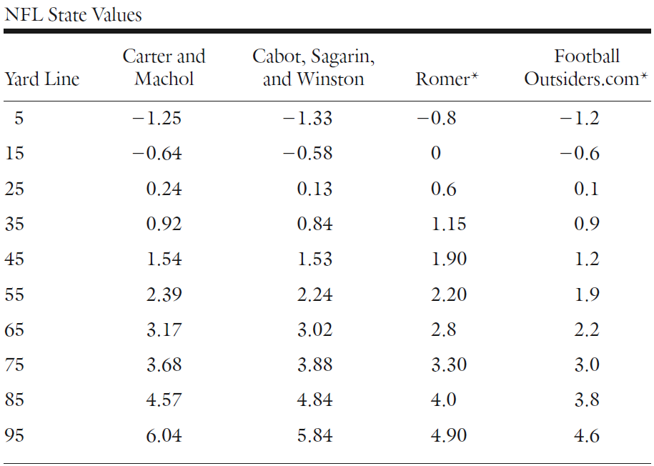
Football States and Values
Comparison of Research on State Values
Approaching Opponent’s Goal Line

Slide 7
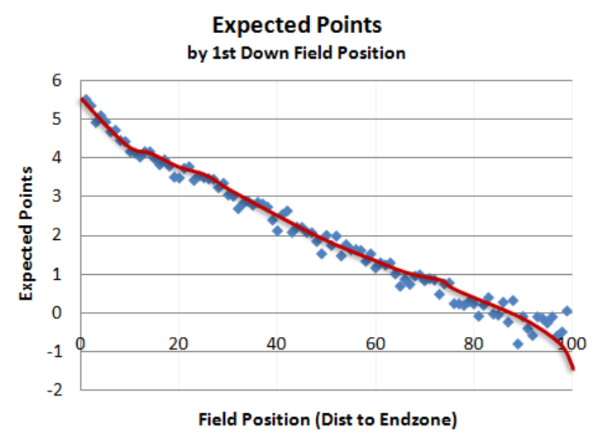
Football States and Values
Takeaways from Analysis
Simulation in Video Game Allowed Data For Scenarios Other than 1st Down
Romer Discovered Teams Should Go on Fourth Down in Most Situations
Over NFL Season There are 40,000 Plays
This Proves That Estimated Value of States Has Considerable Error
Updates from Brian Burke (ESPN)
See Link on Website
“Who Scored Next?”
Ignored Data When |Margin| > 10
Ignored Data in 2nd and 4th Quarter
Argue: This Removes the Impact of Time

Slide 8
Football States and Values
Paper by Yurko, Ventura, and Horowitz (2019)
Used a Multinomial Logistic Regression Model
Estimated Probability of the Next Scoring Event
Calculate Expected Points from this Model
Example
Simplified Scenario (Method Used by CSW)
Football Field is 7 Yards
Need to Get 1 Yard to Get a First Down
Only Have 1 Play to Get a First Down
We Have 50% Chance of 1 Yard and 50% Chance of 0 Yards
When Scored, We Get 7 Points and Opponent Starts on 1 Yard Line
No Field Goals or Punts
$$E\left[Margin\right]=0.3∗6+0.4∗\left(−6\right)+0.2∗3+0.1∗(−3)$$

Slide 9

Football States and Values
Estimating Value of Each States
There are 5 States
Expected Value of Points for Each State
Equations For Expectation (Law of conditional Expectation)
$$Expected Value at i Yard Line=V_{i}$$
$$V_{1}=0.5×V_{2}−0.5×V_{5}$$
$$V_{2}=0.5×V_{3}−0.5×V_{4}$$
$$V_{3}=0.5×V_{4}−0.5×V_{3}$$
$$V_{4}=0.5×V_{5}−0.5×V_{2}$$
$$V_{5}=0.5×(7−V_{1})−0.5×V_{1}$$
Scoring Gives the Ball to Other Team
Failing Gives the Ball to Other Team

Slide 10

Football States and Values
Estimating Value of Each States
Values Can Be Estimated Through Solving Equations
System Can Be Solved = 5 Variables and 5 Equations
Each Yard Line Increases Expectation by 3.5 Points
Is There Anything Particularly Unusual About This Methodology?
$$V_{1}=−5.25$$
$$V_{2}=−1.75$$
$$V_{3}=1.75$$
$$V_{4}=5.25$$
$$V_{5}=8.75$$

Slide 11

Football States and Values
Modification for Punts
Probability of Punting if 5, 4, 3, 2, 1 Yards Away is 0.9, 0.8, 0.2, 0.05, 0
When Punting, the Punter Kicks the Ball 1,2,3,4 Yards Away Approximately
0%, 5%, 10%, and 85% of the Time
Equations for Expectation
$$V_{1}=0.9\left[−0×V_{4}−0.05×V_{3}−0.1×V_{2}−0.85×V_{1}\right]+0.1\left[0.5×V_{2}−0.5×V_{5}\right]$$
$$V_{2}=0.8\left[−0×V_{3}−0.05×V_{2}−0.95×V_{1}\right]+0.2[0.5×V_{3}−0.5×V_{4}]$$
$$V_{3}=0.2\left[−0×V_{2}−1×V_{1}\right]+0.8[0.5×V_{4}−0.5×V_{3}]$$
$$V_{4}=0.05\left[−1×V_{1}\right]+0.95[0.5×V_{5}−0.5×V_{2}]$$
$$V_{5}=0.5×\left(7−V_{1}\right)−0.5×V_{1}$$

Slide 12

Final Inspiration
The Browns ruin careers,
Like ACL tears.
- DJ Mario

